Slide 1
React Intro
Bojan Angjeleski - Semos

Slide 2
Who am I ?
My name is Bojan Angjeleski
I am software engineer with 6+ years of experience
Tech stack is mainly JavaScript with frameworks like (React.js, Node.js, Next.js, Nest.js, Vue.js, Vux.js, Prisma, Vanila JS) but also I work with Python, GO, Java and Swift.
My current company that I work is Meta5 but I was co founder of Panther.io, I have worked in Endava, Pabau, I was co founder of Ways2Help, Box2Help, and Place2go, and I worked freelance for 2-3 years.

Slide 3
Lectures
Short break halfway.
Have a question ? Interrupt me !
Conepts constantly build on each other, so it’s important to undestand everything.
If something isn’t important to know, I’ll ket you know.
I love live examples!
Live coding has its risks. Let me know if you spot an error.

Slide 4
What is React?
Officially – ‘A javascript library for building user interfaces’
Developed by Facebook
React is a tool for building UI components.

Slide 5
How does React work?
React creates a VIRTUAL DOM in memory.
Instead of manipulating the browser's DOM directly, React creates a virtual DOM in memory, where it does all the necessary manipulating, before making the changes in the browser DOM.
React only changes what needs to be changed!
React finds out what changes have been made, and changes only what needs to be changed.

Slide 6
Key takeaways
How to actually get started
Creating with Vite or Next.js (create-react-app) project.
JSX
Folder Structure
Components
Potential errors
Re-using components (Atomic Design)

Slide 7
Actually get started
Installing Node and npm
Node allows us to run Javascript on our desktop (rather then in browser)
Node Package Menager - (npm) lets us install react or other packages.
Find out more here --> https://nodejs.org/en

Slide 8
Install create-react-app
Not recommended (the old way)
npm install -g create-react-app or npx create-react-app
With Vite
npm create vite@latest npm create vite@latest my-vite-react -- --template react
With Next.js
npx create-next-app@latest
Find out more here --> https://vitejs.dev/guide/ , https://nextjs.org/docs/getting-started/installation

Slide 9
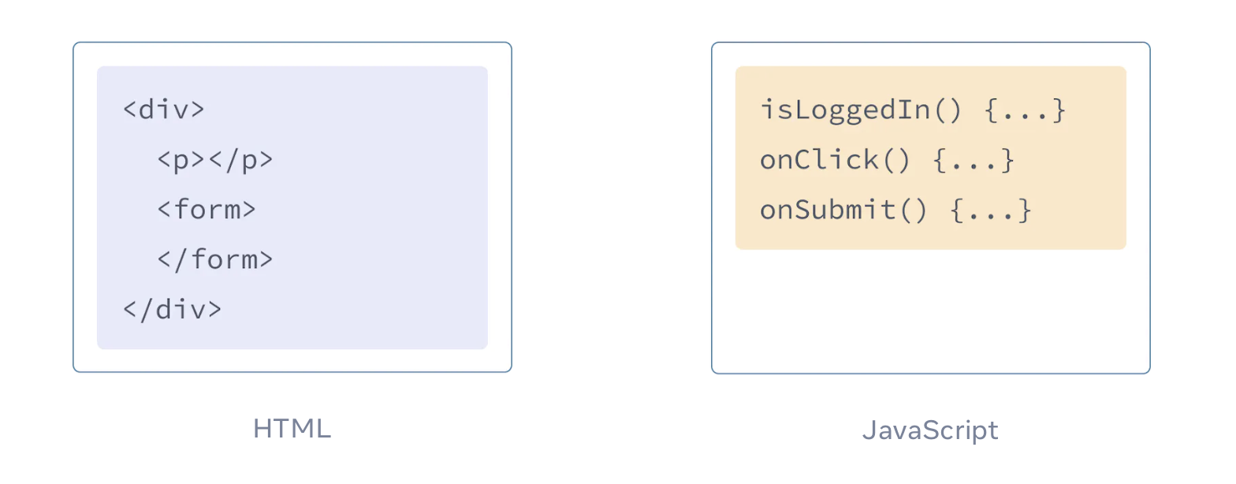
JSX
JSX is a syntax extension for JavaScript that lets you write HTML-like markup inside a JavaScript file.
JSX: Putting markup into JavaScript
ΩΩΩ

Slide 10
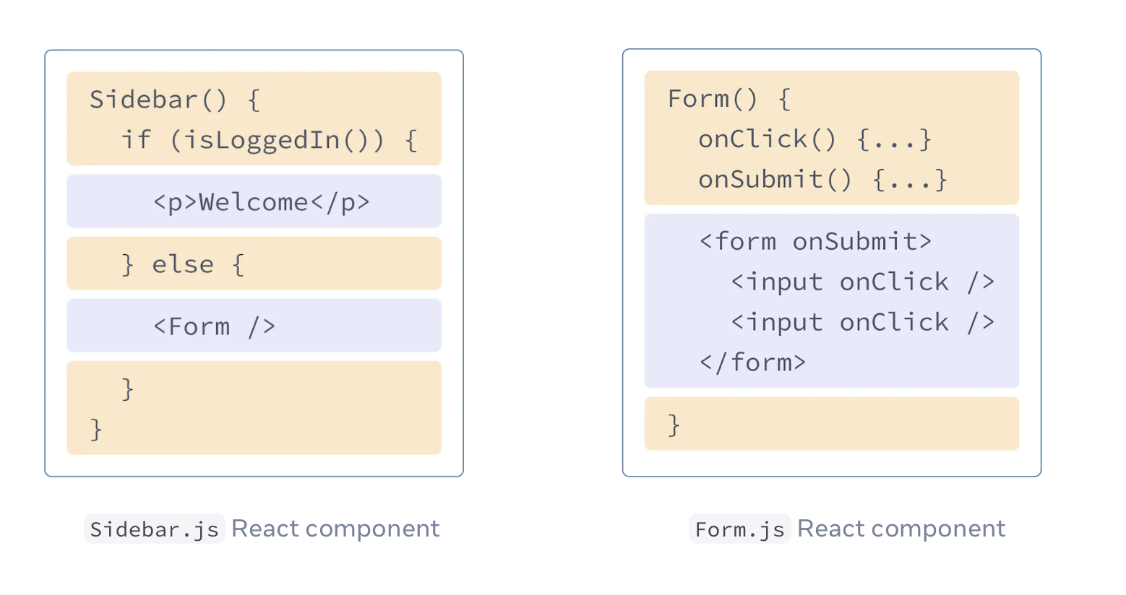
JSX
But as the Web became more interactive, logic increasingly determined content. JavaScript was in charge of the HTML! This is why in React, rendering logic and markup live together in the same place—components.

Slide 11
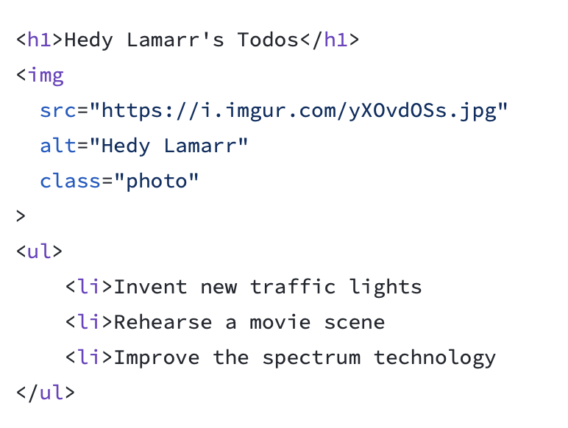
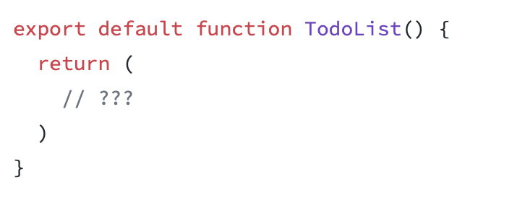
Converting HTML to JSX

Slide 12
Folder Structure
React doesn’t have opinions on how you put files into folders. That said there are a few common approaches popular in the ecosystem you may want to consider.
One common way to structure projects is to locate CSS, JS, and tests together inside folders grouped by feature or route.
Another popular way to structure projects is to group similar files together.

Slide 13
Components
React components use props to communicate with each other. Every parent component can pass some information to its child components by giving them props. Props might remind you of HTML attributes, but you can pass any JavaScript value through them, including objects, arrays, and functions.

Slide 14
Potentional errors
Each child in a list should have a unique key prop.
Prevent usage of Array index in keys
React Hook has a missing dependency: ‘XXX’. Either include it or remove the dependency array
Can’t perform a React state update on an unmounted component
Too many re-renders. React limits the number of renders to prevent an infinite loop
Objects are not valid as a React child / Functions are not valid as a React child
Adjacent JSX elements must be wrapped in an enclosing tag

Slide 15
Re-using components
What is Atomic Design ?
Atomic Design is a methodology that involves breaking down complex systems into smaller, more manageable parts. In React, components are the building blocks of the application.
Atoms: The smallest building blocks:
They are simple UI elements that cannot be broken down any further examples include buttons, icons, input fields, labels, typography, colours, images, form elements, separators and links.
Molecules: Combinations of atoms:
Molecules are combinations of atoms that work together to form a more complex UI element. A molecule could be a search bar that allows users to search for posts. Other examples include form label with input, navigation link with icon, search form with buttons, dropdown menu with options, card with image and text, list item with icon and text.
Organisms: Fully functional components:
Organisms are fully functional components that are made up of molecules and atoms. They are complex UI elements that can be used throughout the application. Organisms could be a list of posts that includes a search bar and buttons to like and share posts.

Slide 16
Homework
Create single page application with your name and picture.

Slide 17
Questions
What is JSX ?
How to create react component ?
Is React a framework or library ?
How to call React Component ?
In which file in hosted React ?

